Slide 1



Select/Change Current Location
Back button image:
https://image.flaticon.com/icons/png/512/93/93634.png
Home button image:
https://static.thenounproject.com/png/610387-200.png
View pubs/
Create Pub Crawl
Filter Pubs
Beer mug image:
View Current Pub Crawl
http://clipart-library.com/cartoon-beer-mug.html

Slide 2
What features would you like your pubs to have?
Serves Food:
Swiping to the left will take the user to the right hand screen which will be the list of pubs. There is no screen to the left so swiping to the right will do nothing.
The Apply Filters button may not be needed if we can filter the pubs in real time as the user makes each selection
No
No preference
Yes
Serves Real Ale:
No
No preference
Yes
Allows dogs:
No
No preference
Yes
Has a TV:
No
No preference
Yes
Allows dogs:
No
No preference
Yes
Allows dogs:
No
No preference
Yes
Apply Filters

Slide 3
You are currently viewing pubs in Aberystwyth, to add a pub to your pub crawl, hit the tick box, or choose to create a random pub crawl!
Swiping to the right will take the user to the left hand screen
which will be filters.
The Cambrian Hotel
Alexandra Rd,
Aberystwyth SY23 1LG
More details
Swiping to the left will take the user to the right hand screen
which will be the pub crawl management screen.
Harleys
Eastgate,
Aberystwyth SY23 2AR
More details
The user will be able to scroll down to view other pubs, though the button and top menu bar will stay in a fixed location.
Pier Pressure
Royal Pier, Marine Terrace,
Aberystwyth SY23 2AZ
More details
BAR46
46 Bridge St,
Aberystwyth SY23 1QB
More details
Scholars
10 Queen's Rd,
Aberystwyth SY23 2HH
More details
Rummers Wine Bar
Add checked pubs to your pub crawl

Slide 4
You have added the following pubs to your pub crawl, drag them around to select an order, and select a start and interval time for your crawl.
The Cambrian Hotel
Pier Pressure
Harleys
Scholars
Rummers Wine Bar
The user can drag and drop their pubs into their desired order, then choose a start and interval time for their crawl. The start and interval times will look like:
:
mins
Until the user enters info into them. If the user does not enter anything there will either be an untimed pub crawl, or a default (up to group to decide).
Select a start time:
Select an interval time:
19:00
30mins
Add checked pubs to your pub crawl

Slide 5
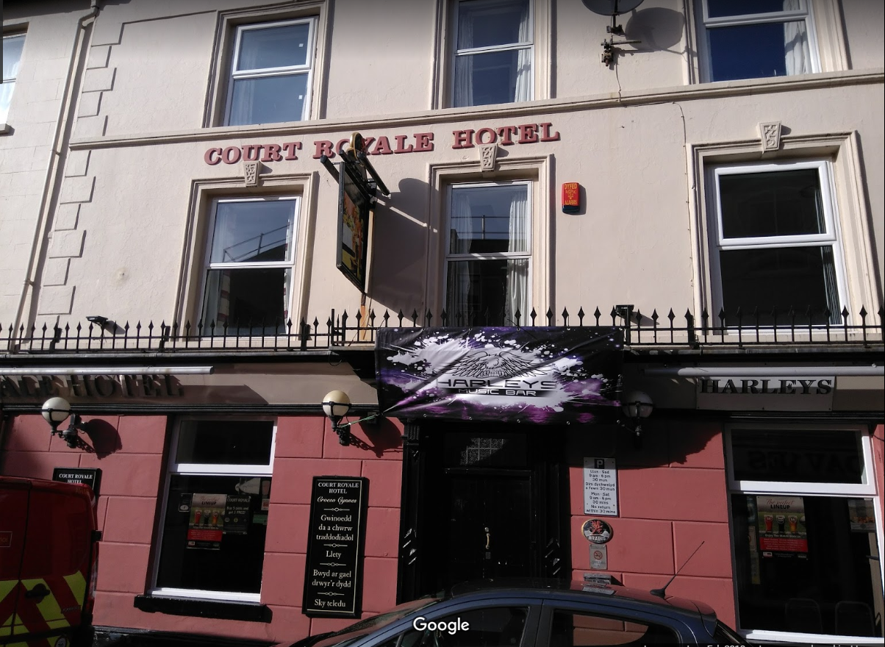
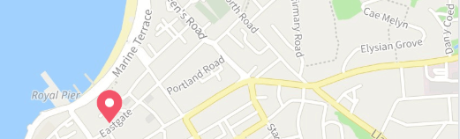
Court Royal Hotel (Harley’s)
Features: Club, Loud Music
Court Royal Hotel, also known as Harleys is a pub/club which is largely frequented by students of the local uni. The pub has a very lively atmosphere when you arrive at its peak time and its bar staff are very efficient even at this time. The pricing of the drinks are at an average for a pub in a student town.

Slide 6
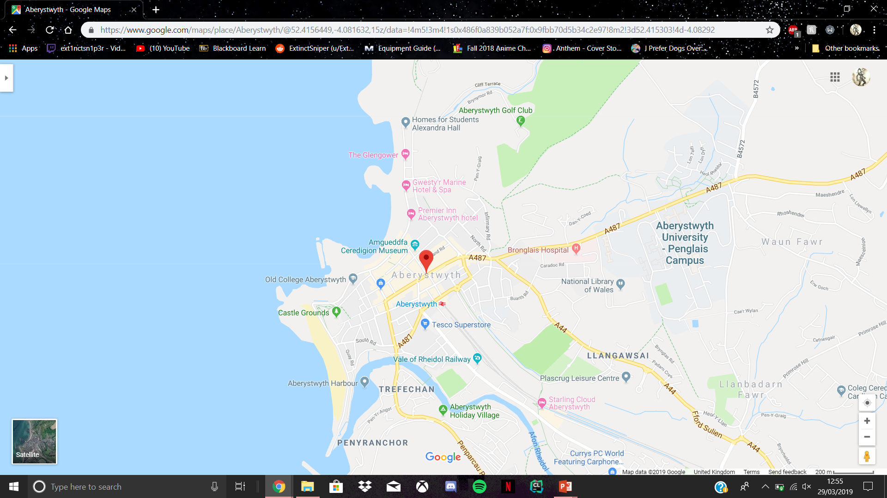
Court Royal Hotel (Harley’s)
21 Eastgate Street, Aberystwyth
More Details
Inn on
NEXT PUB
Time:

Slide 7
You haven’t created a Pub Tour list yet please press one of the buttons below
New Pub Tour
Create random Pub Tour with currently selected Features

Slide 8
CONGRATULATIONS
You Completed Your Pub Tour!

